Slide 1
P, NP, NP Complete, NP Hard Problems
&
Approximation Algorithms

Slide 2
Optimization Problem
Optimization problems are those for which the objective is to maximize or minimize some values.
For example,
0/1 Knapsack Problem.
Finding the shortest path between two vertices in a graph.
Travelling Sales Person Problem (TSP)

Slide 3
Decision Problem
There are many problems for which the answer is a Yes or a No. These types of problems are known as decision problems.
For example,
Whether a given graph can be colored by only 4-colors?
Decision version of optimization problem: example:
Is there exist a tour in TSP of cost less than or equal to M (for some M).
Is there exist a solution to 0/1 Knapsack problem which has profit greater than or equal to M?

Slide 4
Class P Problem
Class P Problems: A decision Problem X is said to be in class P, if it can be solved using deterministic Turing machine (deterministic algorithm) in polynomial time.
Example: Sorting, Searching, Finding shortest path, container loading problem etc.

Slide 5
Class NP Problems
Class NP problems: NP stands for Non deterministically Polynomial
A decision problem X is said to be in class NP if it can be solved in polynomial time using non-deterministic Turing machine (Probabilistic algorithm, “guess”).
Equivalently: A problem X is said to be in NP if the solution is verified in polynomial time using deterministic algorithm.
Example: Decision version of 0/1 knapsack problem, TSP
Not in NP: Optimization problem TSP, 0/1 Knapsack problem etc.

Slide 6
P Vs NP
Million Dollar question ! P = NP ? OR P != NP?
Clearly class P is subset of class NP (Since any problem which can be solved in polynomial time using deterministic machine can also be solved using non-deterministic algorithm.
But whether NP is subset of P or not is a big research problem!
Why this research question is important? (Discussed after explain NP complete and NP hard problems)

Slide 7
NP-Complete
A problem is NP-complete if it is both NP-hard and in NP.
i.e., A problem X is said to be NP-complete if
X is in NP (verifiability) AND
X is NP–hard (reducibility)

Slide 8
NP-hard
Polynomial-time reductions: If problem A can be polynomial-time reduced to problem B, then it stands to reason B is at least as hard as A.
NP-hard: A problem is NP-hard if every problem in NP can be polynomial time reduced to it.
In Practice: To prove a problem X is NP-hard, take a known NP-complete problem Y and polynomial time reduce it to X.

Slide 9
Examples of NP-Complete Problems
Knapsack decision version
3-Partition: given n integers, can you divide them into triples of equal sum?
Traveling Salesman Problem decision version
Minesweeper, Sudoku, and most puzzles
SAT: given a Boolean formula (and, or, not), is it ever true? x and not x → NO
3-coloring a given graph.

Slide 10
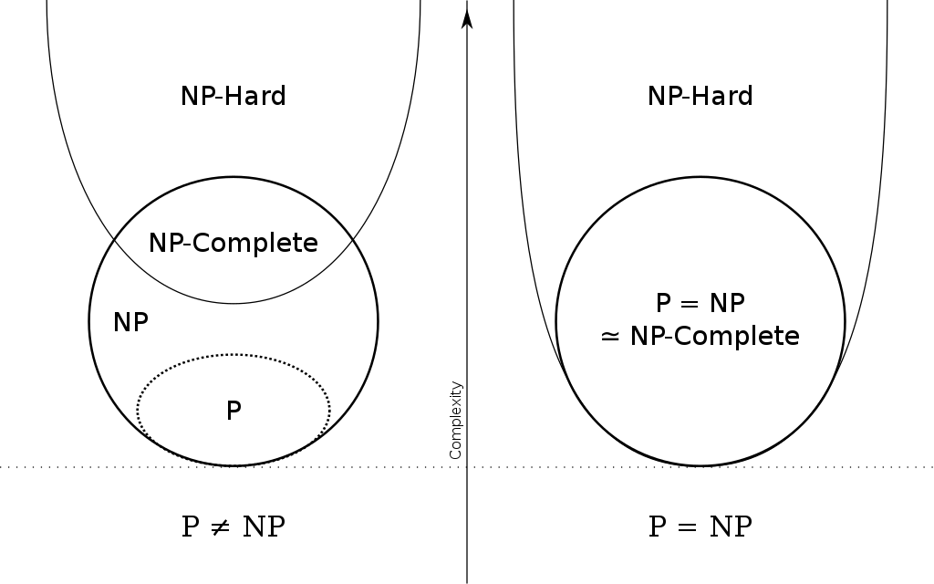
P = NP and P!= NP Scenario

Slide 11
Approximation Algorithm
If a problem is NP-complete, we are unlikely to find a polynomial-time algorithm for solving it exactly.
but this does not imply that all hope is lost.
There are two approaches to getting around NP-completeness.
If the actual inputs are small, an algorithm with exponential running time may be perfectly satisfactory.
It may still be possible to find near-optimal solutions in polynomial time. In practice, near-optimality is often good enough.
An algorithm that returns near-optimal solutions is called an approximation algorithm.

Slide 12
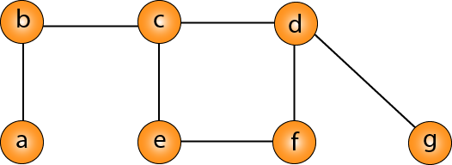
Approximation Algorithm for Vertex Cover Problem
Vertex-cover: A vertex cover of undirected graph G = (V, E) is a subset V’ of V such that if <u, v> is an edge in G, then either u or v in V’ (or both). The size of vertex cover is number of vertices contained in V’
The vertex-cover problem is to find a vertex cover of minimum size.
We call such a vertex cover an optimal vertex cover. This problem is NP-hard, since the related decision problem is NP-complete.
V1=V V2 = {b, c, d, f, g} V3={ c, d, e, f, g}
V4 ={a, b, c, e, f} V5={c, d, b, f}
V6={b, e, d} V7={c, d, e, a}
Vertex Cover: V1, V2, V5, V6 V7
Min. Vertex Cover: V6
Not vertex cover: V3 and V4

Slide 13
Approximation Algorithm for Vertex Cover
Simple approach (Nixon’s Algorithm): Repeatedly select a vertex of highest degree, and remove all of its incident edges
Using this approach for the graph given in previous slide we get
a, b, c, d, e, f, g
Degree[]=[1, 2, 3, 3, 2, 2, 1]
First select c or d: V’={c}
Updated degree[]=[1, 1, 0, 2, 1, 2, 1]
Select d or f: V’={c, d} updated degree[] = [1, 1, 0, 0, 1, 1, 0]
Select any one vertex arbitrarily from a, b, e, f: V’={c, d, a}
Updated degree[]=[0, 0, 0, 0, 1, 1, 0] Select any vertex e or f : V’={c, d, a, e}
Complexity : O(n²) [adjacency matrix representation]
Selecting highest degree vertex: O(n), even if all vertices selected complexity of this step is O(n²)
Updating degree: O(n) for each vertex, so n vertex O(n²)

Slide 14
Approximation algorithm for Travelling Salesperson Problem(TSP)
Euclidean TSP Approximation Algorithm:
1. Compute a minimum spanning tree T connecting the cities. (Prim’s algorithm)
2. Visit the cities in order of a preorder traversal of T.
3. Get the Hamiltonian cycle and find the tour cost.
Complexity Analysis:
Prim’s Algorithm Complexity : O(n²) (Adjacency matrix representation)
Preorder Traversal of Tree : O(n)
Cost of tour calculation: O(n)
Complexity of the approximation algorithm: O(n²)

Slide 15
Thank You

